Slide 1
Creating your Own Workout
Let’s Get Jacked
Fitness and Conditioning 11/12 - 2020

Slide 2
Principle of Muscle Balance
Abs – Two Ways to Think About
Rectus Adominus
Obliques
Stabilization
Erector Spinea/Hamstrings
Anti-flexion
Anti- extension
Anti – rotation and lateral flexion
(Full body or hip rotation could be included)
Chest- (Push)
Back (Pull)
Legs
Chest (Push or squeeze)
Back (Pull)
Legs
Shoulder
Leg (hamstring)
Bicep
Triceps
Other muscles that could be included in your workout:
Calves/Anterior Tibialis
Rotator Cuff
Adductors/ Abductors
Trapezius
Others?

Slide 3
Full Body Workout vs. Split Routine
Need to remember the Principle of Recovery Time – after strength training the body will need from 48-72 hours to recover before again damaging the muscles. If you do not give your body that rest time it will lead to injury or decreased gains.
If a split routine you can rest your body by working as follows:
Option One
Day one : upper body
Day two: lower body
Option Two
Day One: Push exercises
Day two: Pull Exercises
Day 3: Legs
Option Three
???
Just keep in mind the principle of recovery time here.

Slide 4
Ways to Make Workouts More Functional
Body Position –
Least Functional – Seated or
Lying Down
Stability
Least Functional – Little need to activate Core or Stabilizing Muscles
Muscles involved in activity
Least Functional- One muscle,, one joint movement

Slide 5
Ways to Make Workouts More Functional
Body Position –
More Functional – Standing, One leg?
Stability
More Functional – dumbbells, Push ups?
Muscles involved in activity
More Functional- multiple joints involved in exercise – idea of training movement patterns, not muscles

Slide 6
Good Sources of Information- Aim for Best Practices, not Cool Exercises (alright, try to find Cool Exercises that are best practice!)
Is the trainer Certified?.
Are the exercises at the right level for your fitness level?
Do the exercises seem Safe and relatively easy to perform?

Slide 7
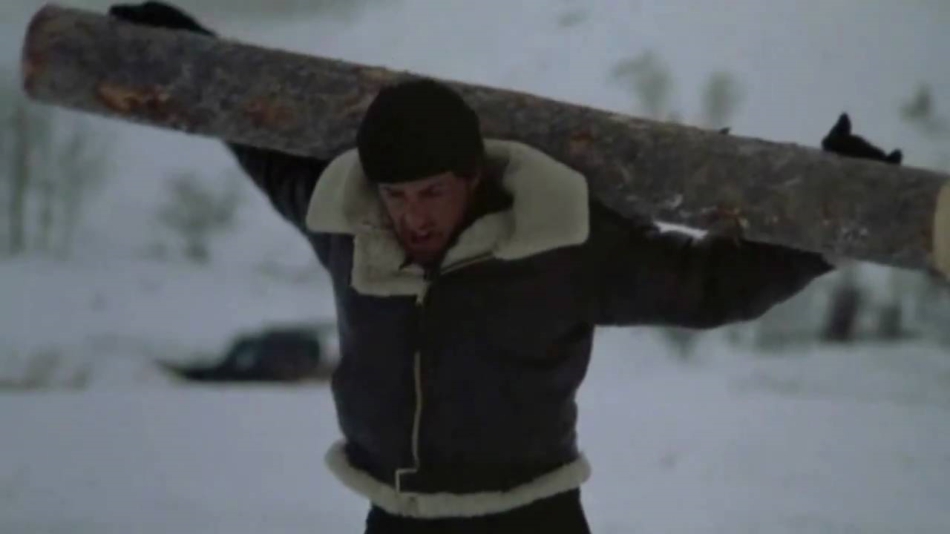
Old School is Out – Rocky Four is not Best Practice!

Slide 8
Let’s Get Jacked Started!
1. Need to write out workout on attached sheet and include the major muscle/movement pattern being targeted by each exercise.
For example:
Bench Press
Pectoralis Major (or Chest)
2,Need to include at least four new exercises in your workout – Highlight these exercises and include the reliable source you have used.
Old Workout sheets can be found on my website along with some articles to help you along:
Mike Boyle on Core Training
Stack.com article “3 popular core exercises pro athletes would never do”
Stack.com article “27 awesome core exercises for athletes”
Exercises that should be in your routine

