Slide 1
National Strength and Conditioning Association
NSCA’s Guide to Program Design

Slide 2
How the Body Reacts to Working Out

Slide 3
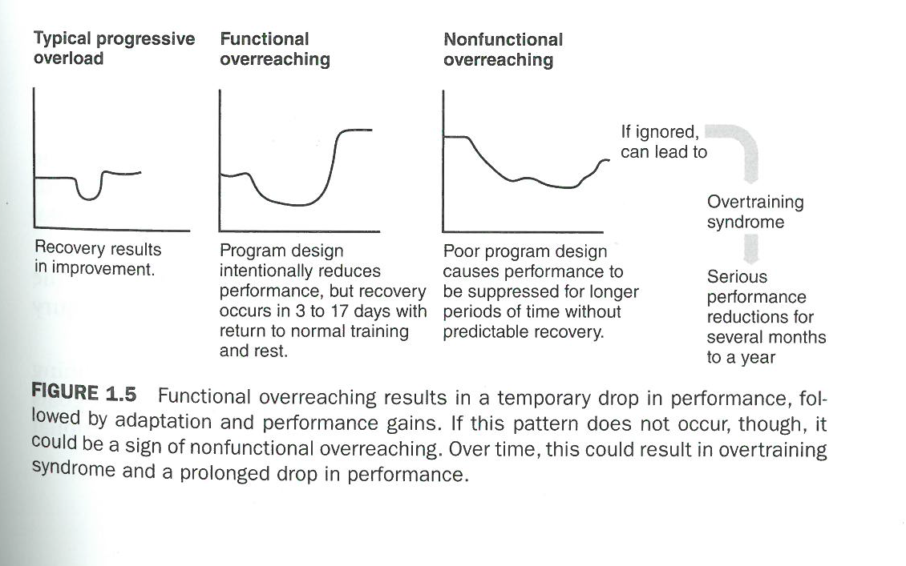
How the Body Reacts to Working Out – Look #2

Slide 4
How Many Repetitions Should I Perform?
Notes:
This needs to be balanced with the following information found just below this chart in the textbook “Although each training zone on this continuum has its advantages, athletes should not devote 100% of their training time to one genral zone as a way to avoid encountering training plateaus or overtraining. It is recommended that novice to intermediate lifters resistance train with loads corresponding to 67% to 85% of 1 RM for 6 to 12 repetitions.

Slide 5
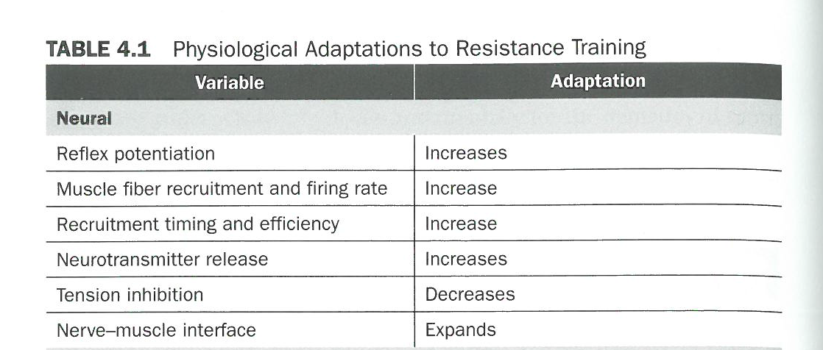
How the Body Changes from Working Out

Slide 6
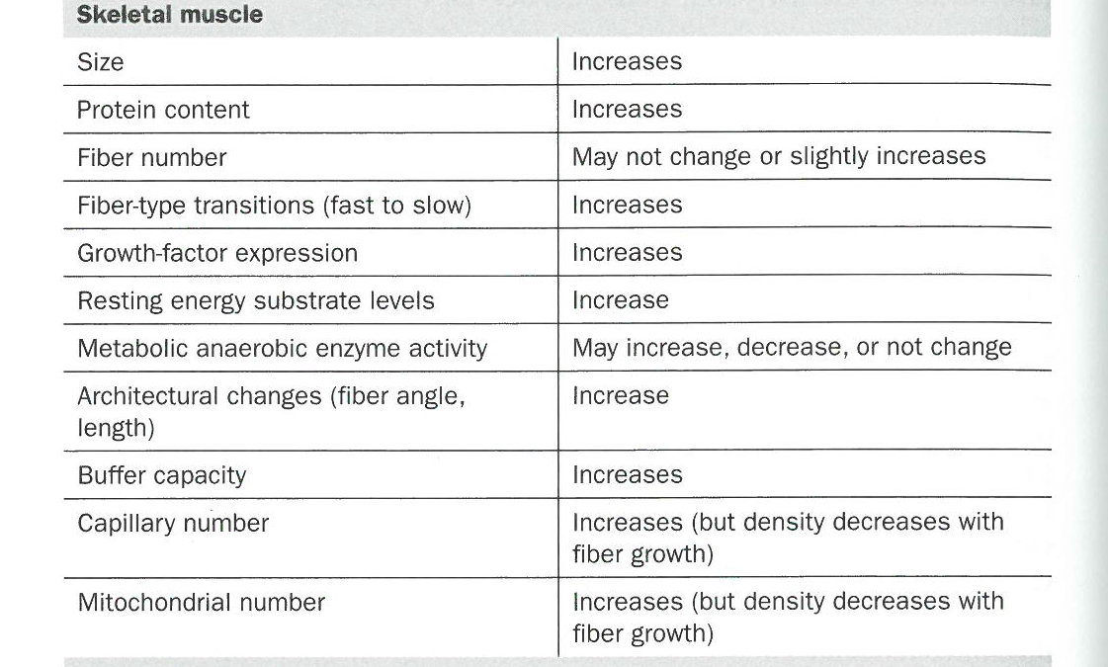
How the Body Changes from Working Out

Slide 7
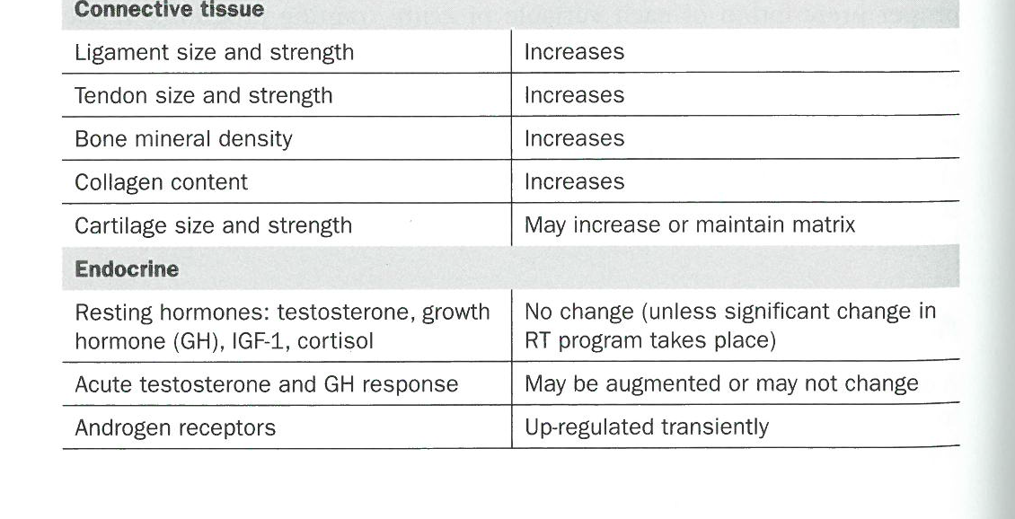
How the Body Changes from Working Out

Slide 8
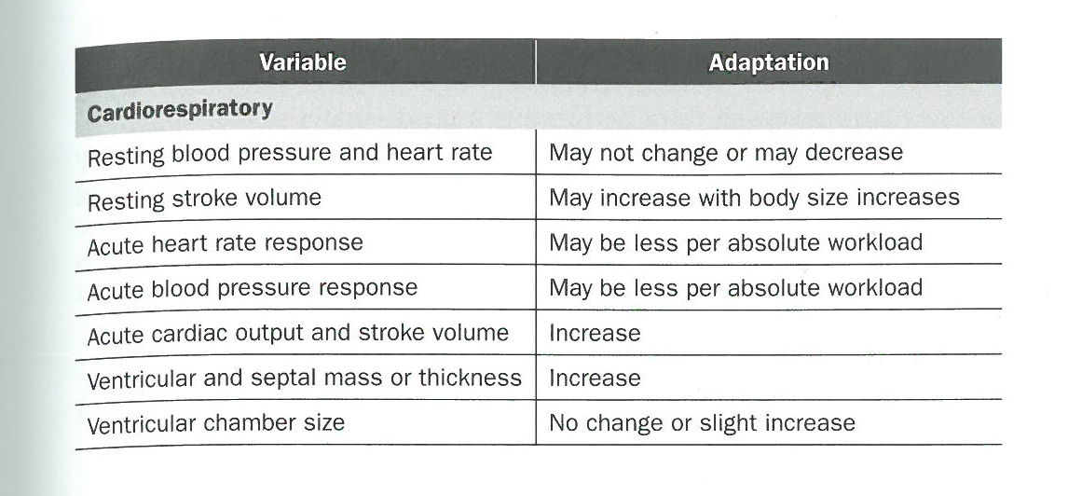
How the Body Changes from Working Out

Slide 9
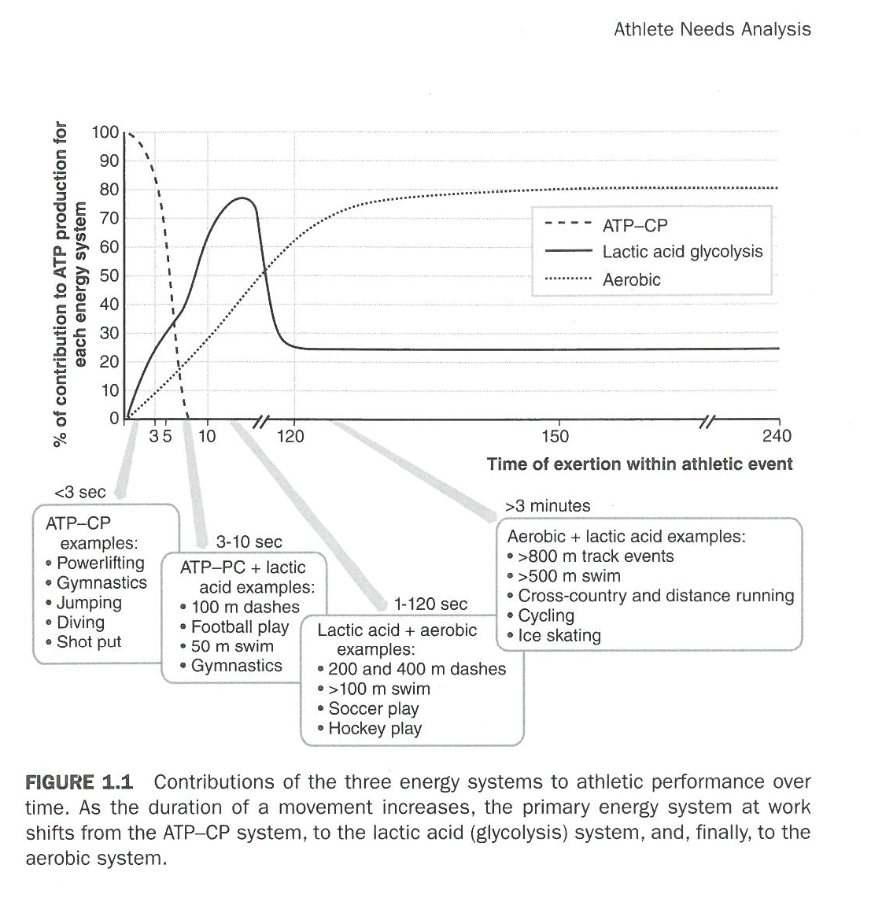
Contributions of the Energy Systems for Different Sports

Slide 10
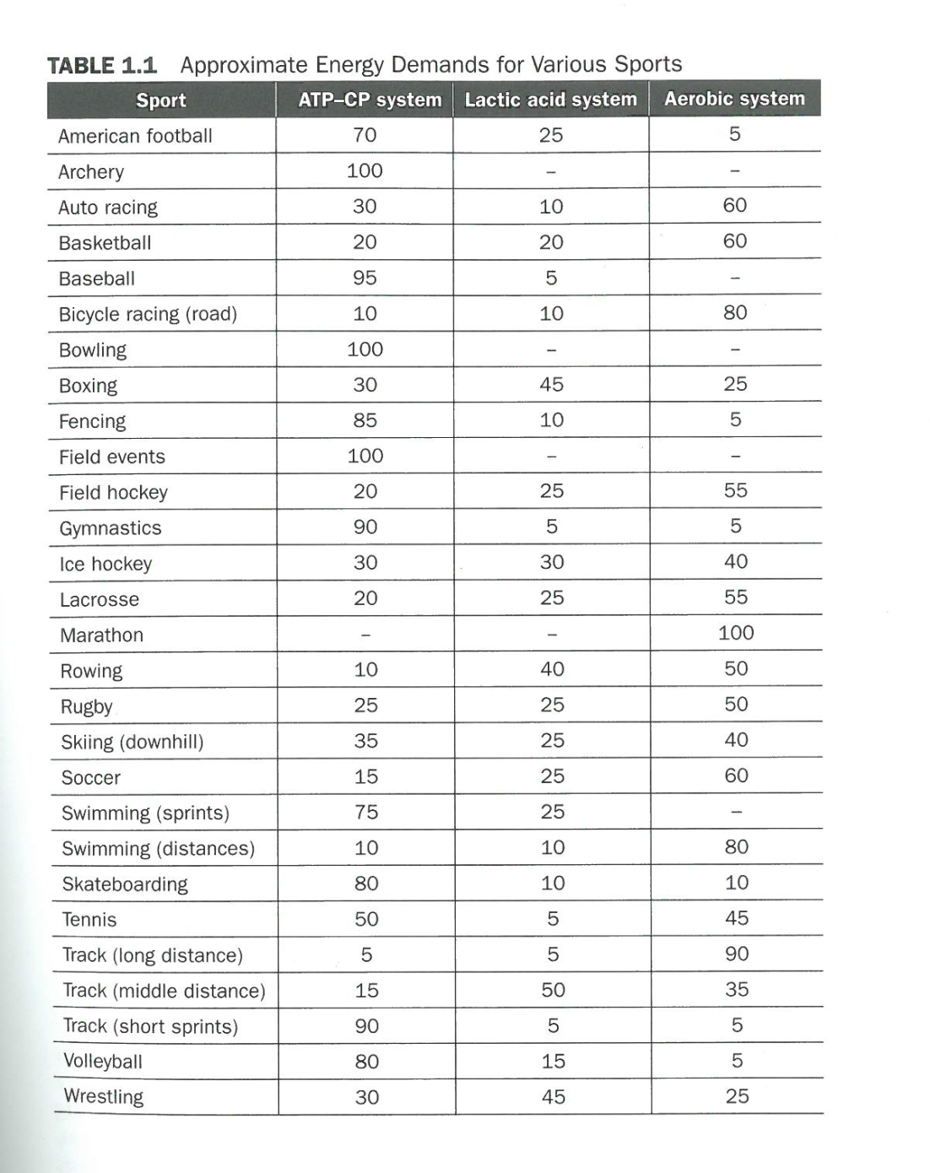
Contributions of the Energy Systems for Different Sports

Slide 11
Contributions of the Energy Systems for Different Sports

